Slide 1
Cloud Computing
SEWP ZG527

Slide 2
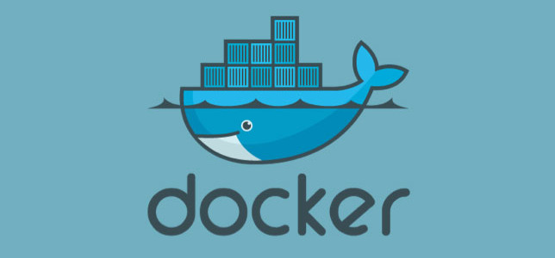
Notes:
RL 2.4

Slide 3
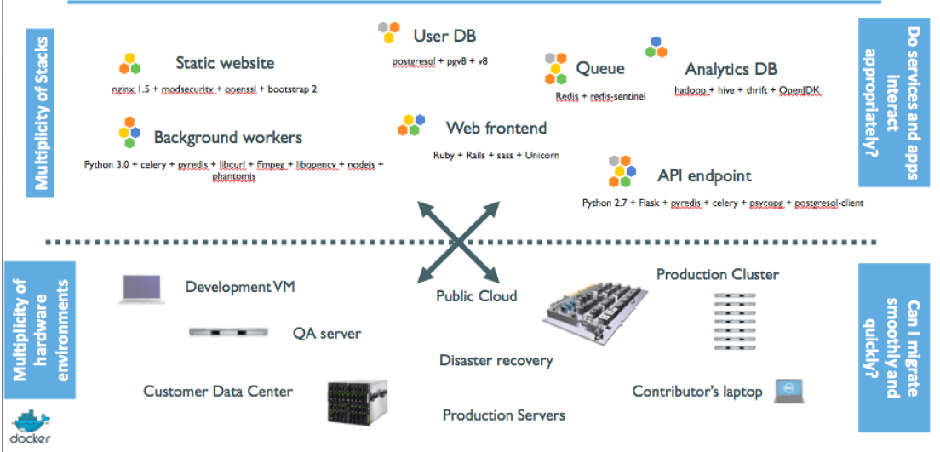
Current Problem the Industry is facing

Slide 4
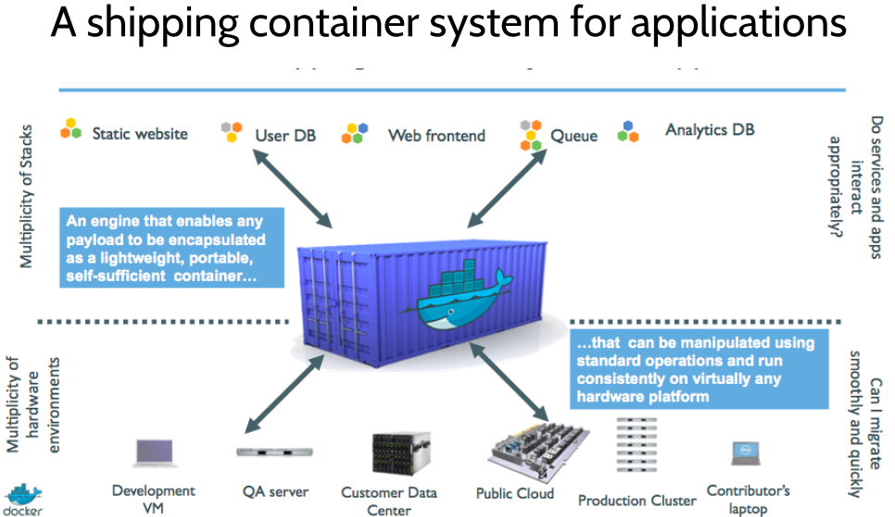

Slide 5

Dockers
All applications have their own dependencies, which include both software and hardware resources.
Docker is a mechanism that helps in isolating the dependencies per each application by packing them into containers.
In terms of technology, it provides cloud portability by running the same applications in different virtual environments.
Containers are scalable and safer to use and deploy as compared to regular approaches.

Slide 6
Virtual Machines
Virtual machines are used extensively in cloud computing.
Isolation and resource control have continually been achieved through the use of virtual machines.
Virtual machine loads a full OS with its own memory management and enable applications to be more efficient and secure while ensuring their high availability.
App
App
App
App
App
App
OS
OS
OS
Operating System
Hypervisor
Hardware
Hardware
Traditional Stack
Virtualized Stack

Slide 7
How are Docker Containers different from a Virtual Machine?
Virtual machines have a full OS with its own memory management installed with the associated overhead of virtual device drivers.
Docker containers are executed with the Docker engine rather than the hypervisor.
Containers are therefore smaller than Virtual Machines and enable faster start up with better performance, less isolation and greater compatibility possible due to sharing of the host’s kernel.

Slide 8
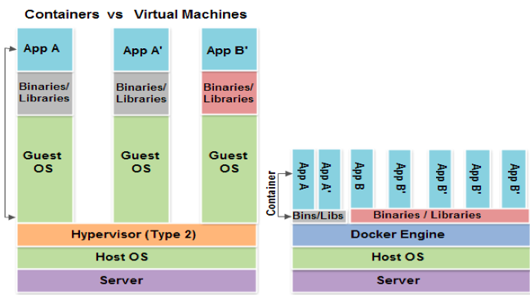
How are Docker Containers different from a Virtual Machine?

Slide 9
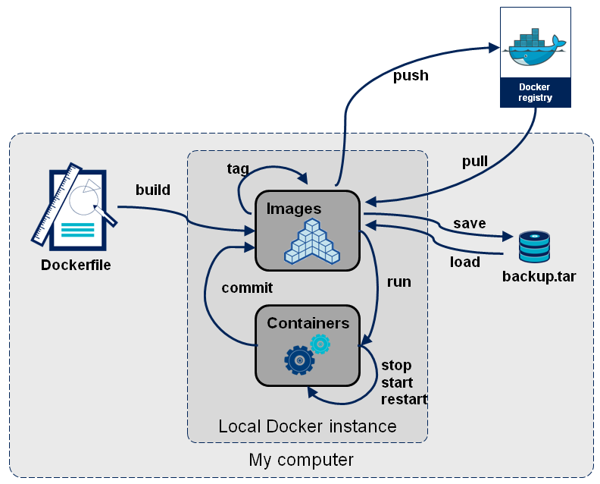
Docker Container Lifecycle ……
• The Life of a Container
– Conception
• BUILD an Image from a Dockerfile
– Birth
• RUN (create+start) a container
– Reproduction
• COMMIT (persist) a container to a new image
• RUN a new container from an image
– Sleep
• KILL a running container
– Wake
• START a stopped container
– Death
• RM (delete) a stopped container
• Extinction
– RMI a container image (delete image)

Slide 10
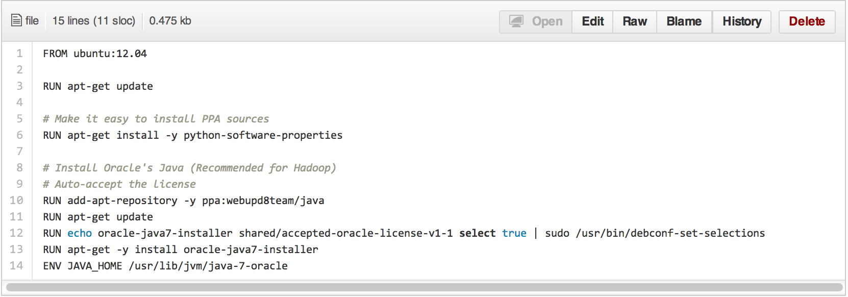
Dockerfile ……
• Like a Makefile (shell script with keywords)
• Extends from a Base Image
• Results in a new Docker Image
• Imperative, not Declarative
A Docker file lists the steps needed to build an images
• docker build is used to run a Docker file
• Can define default command for docker run, ports to expose, etc

Slide 11
https://docs.docker.com/engine/installation/windows/
Thank you

